Slide 1

LAB 19
January 2025

Slide 2
CONTENTS
01
Specification
02
Creating the Simple Sequence Assertion
03
Creating the Complex Sequence Assertion
04
Achieved Outcomes.
Testing the Register Design

Slide 3
Specification
01

Slide 4
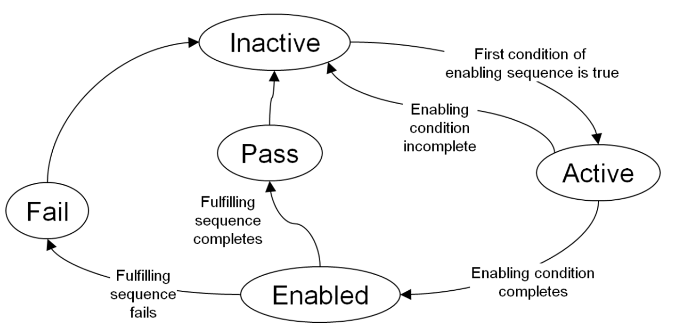




1. Specification
01
A multicycle sequence-based assertion can be in one of several states as below:
State | Description
Inactive | Waiting for the enabling sequence to begin
Active | Enabling sequence started and being evaluated
Enabled | Enabling sequence completed; evaluating fulfilling sequence
Pass | Fulfilling condition completed
Fail | Fulfilling condition failed
Notes:
IC: Integrated Circuit

Slide 5
Creating the Simple Sequence Assertion
02

Slide 6
2. Creating the Simple Sequence Assertion
01
Working in the lab19-svaseq directory, edit the seqtest.sv file.
Create and assert a property SIMPLE_SEQ, clocked off the negative edge of CLK, to the following specification:
The enabling sequence is A at logic 1 followed immediately by B at logic 1 followed immediately by C at logic 1 (in consecutive samples).
The fulfilling sequence follows in the cycle after the enabling sequence completes and is J at logic 1 followed by K at logic 1 in consecutive samples.
The property is disabled if X is at logic 1 for any cycle.
Examine the rest of the testbench and make sure you understand its operation.
Note that for each subtest, the testbench passes a character string to a subprogram do_test.
The ; character is the cycle delimiter. Other characters correspond to signals driven high by the subprogram during that clock cycle.
Leave the commented out section – this is for testing the complex sequence.
Notes:
IC: Integrated Circuit

Slide 7
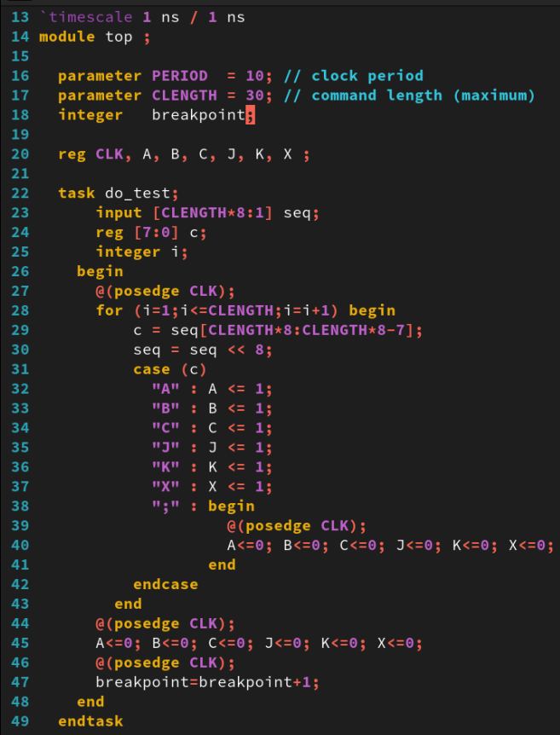
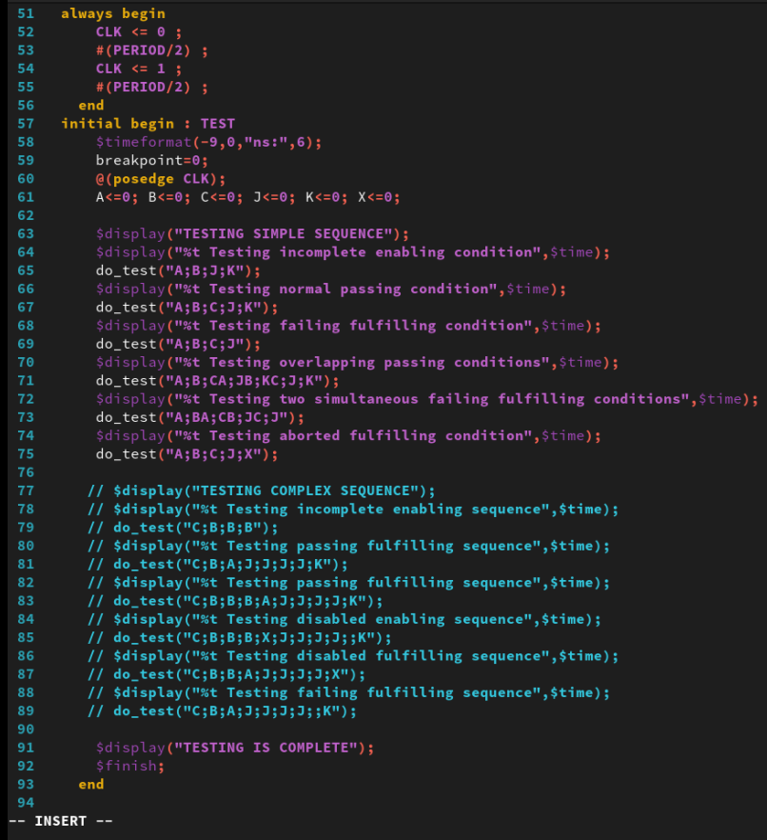
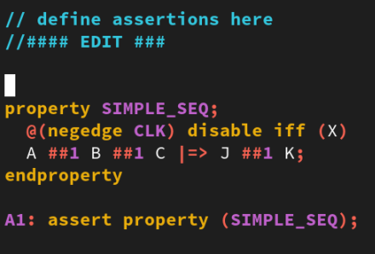
2. Creating the Simple Sequence Assertion
01
uncomment
edit SIMPLE_SEQ
comment
seqtest.sv
Notes:
IC: Integrated Circuit

Slide 8
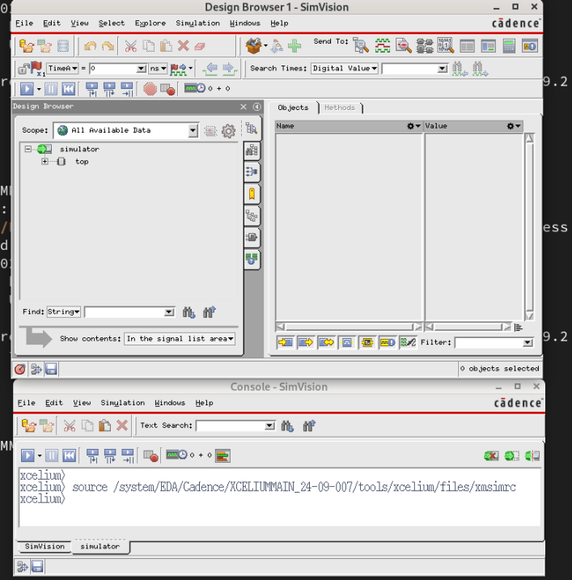
2. Simulating the Simple Sequence Assertion
02
Simulate your design in GUI mode using the following xrun options:
xrun seqtest.sv -gui –access +rwc –linedebug
Then Design Browser 1 - SimVision will open as below:
Notes:
IC: Integrated Circuit

Slide 9
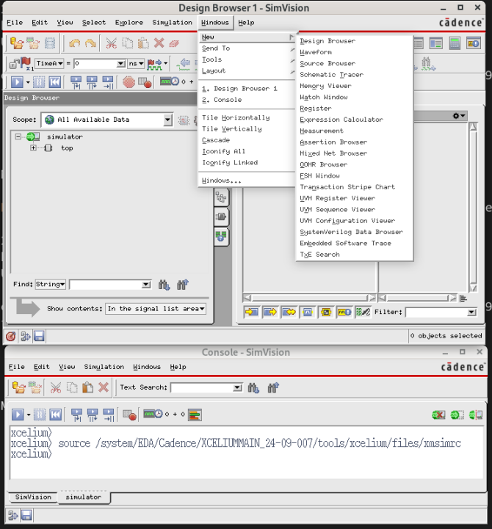
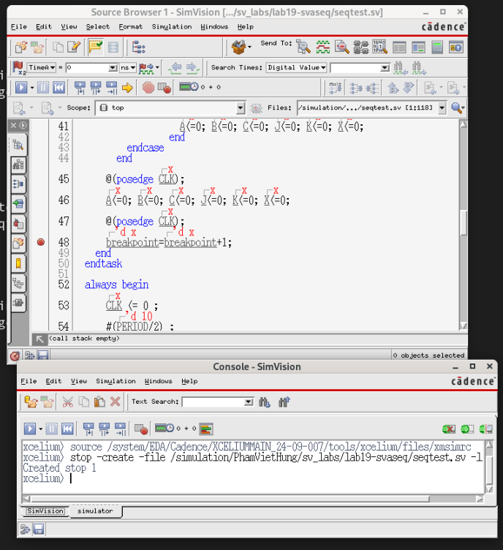
2. Simulating the Simple Sequence Assertion
02
When Design Browser1 - SimVision open, clicking on the icon or by going to Windows – New – Source Browser.
After following the instructions above: Source Browser 1 - SimVision will open.
Set a breakpoint at the line which contains breakpoint=breakpoint+1(line 48) in the task do_test. The result as below:
Notes:
IC: Integrated Circuit

Slide 10
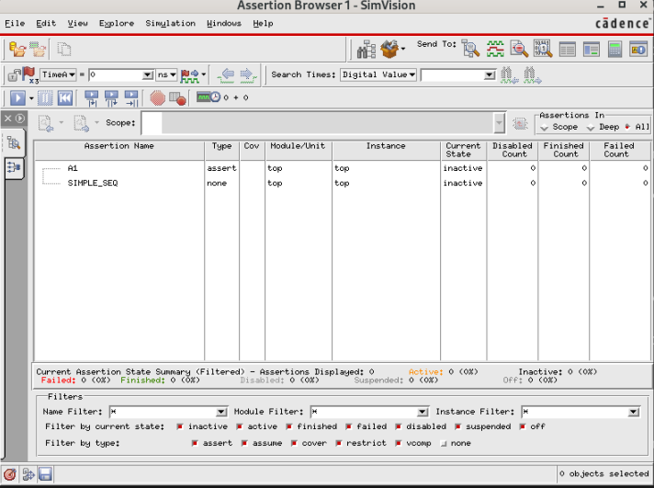
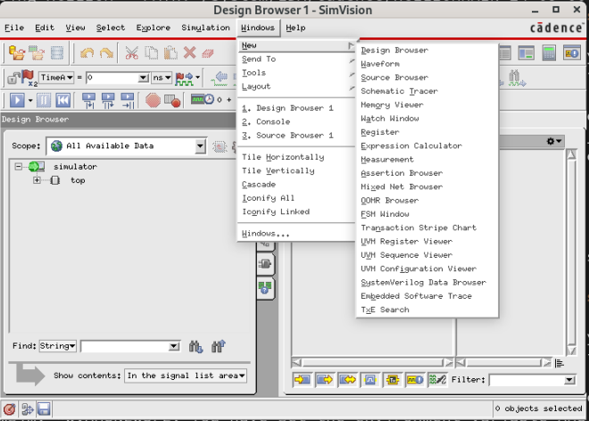
2. Simulating the Simple Sequence Assertion
02
At Design Browser1 - SimVision, clicking on the icon or by going to Windows – New – Assertion Browser.
After following the instructions above: Assertion Browser 1 – SimVision will open
The Assertion Browser no longer shows all assertions by default.
You need to item All at Assertions In on Assertion Browser 1 – SimVision.
Then Assertion Name will appear as below:
Notes:
IC: Integrated Circuit

Slide 11
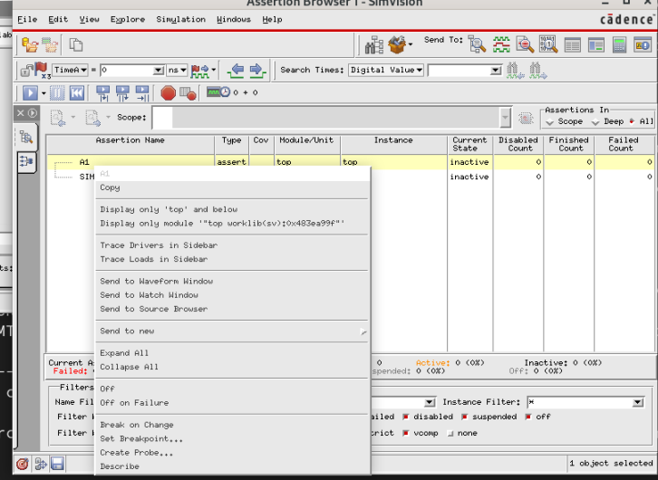
2. Simulating the Simple Sequence Assertion
02
Add A1 assertions name to the waveform window.
Run simulation. You have successfully created the simple sequence assertion, you should see three assertion failures. Two of the failures occur within the same subtest.
Notes:
IC: Integrated Circuit

Slide 12
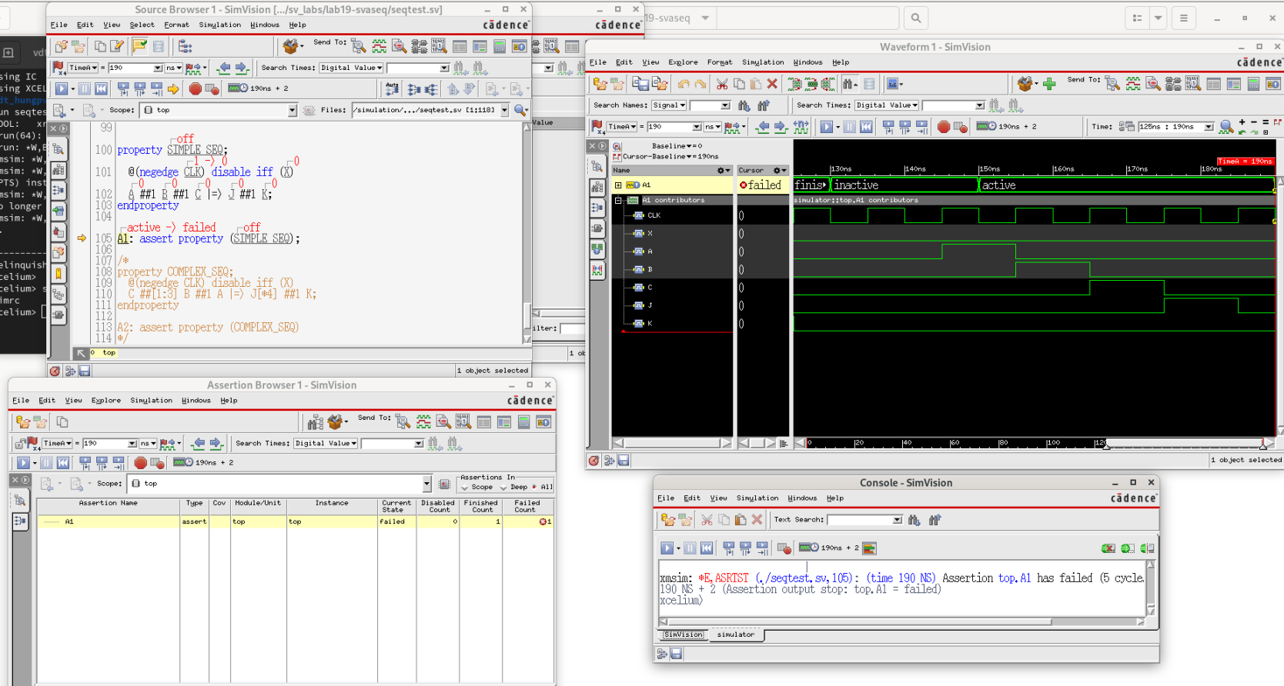
2. Simulating the Simple Sequence Assertion
02
First assertion failures at 3rd run and the 3rd subtest(see details at waveform) of the simple assertion fails to complete the fulfilling sequence – J is not immediately followed by K.
The result as below:
Notes:
IC: Integrated Circuit

Slide 13
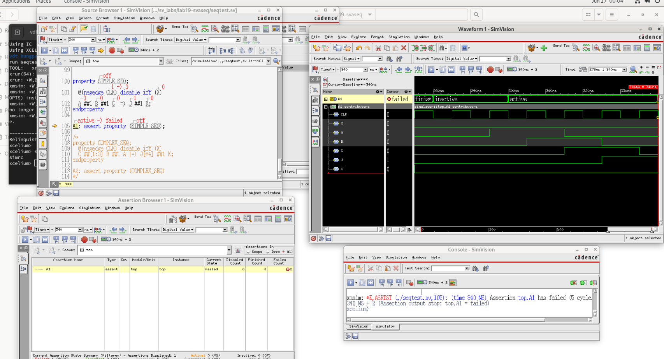
2. Simulating the Simple Sequence Assertion
02
Second assertion failures at 6th run and the 5th subtest of the simple assertion fails to complete the fulfilling sequence for two overlapping traces of the sequence. Both traces fail because K does not immediately follow J. These two failures occur in consecutive cycles. The result as below:
Notes:
IC: Integrated Circuit

Slide 14
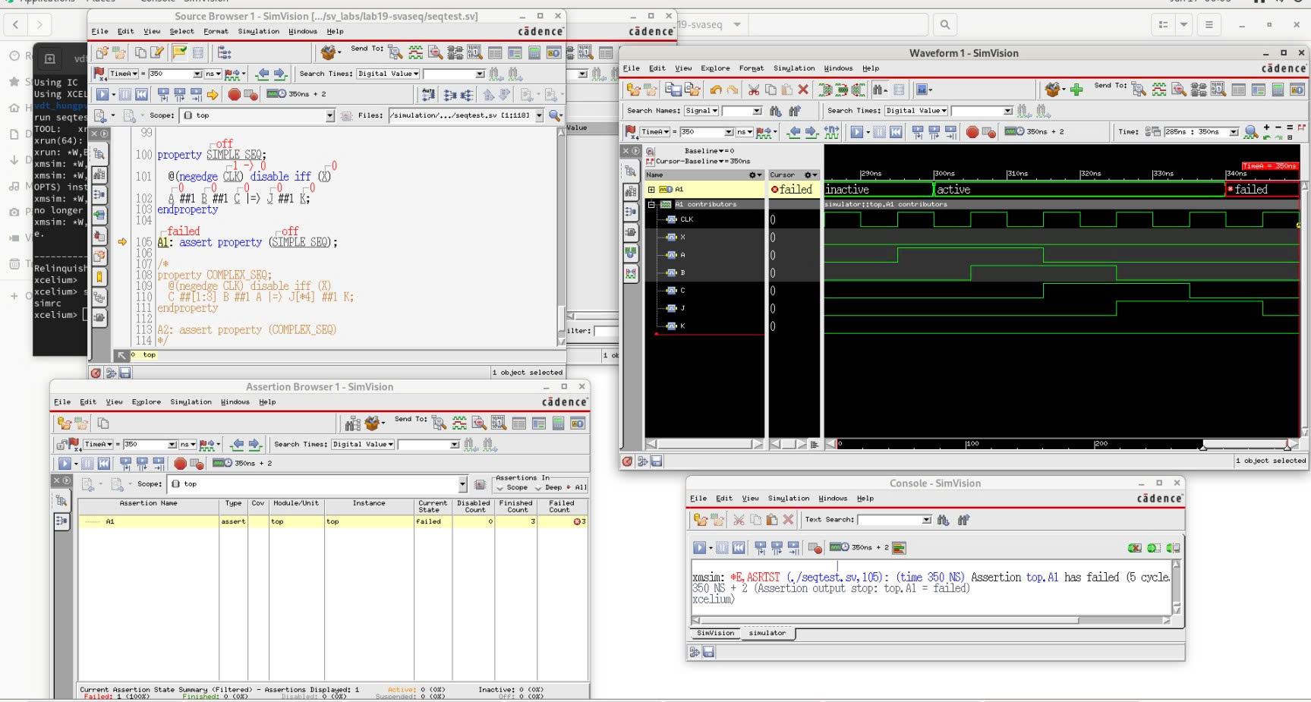
2. Simulating the Simple Sequence Assertion
02
Third assertion failures at 7th run and the 5th subtest of the simple assertion fails to complete the fulfilling sequence for two overlapping traces of the sequence. Both traces fail because K does not immediately follow J. These two failures occur in consecutive cycles. The result as below:
Notes:
IC: Integrated Circuit

Slide 15
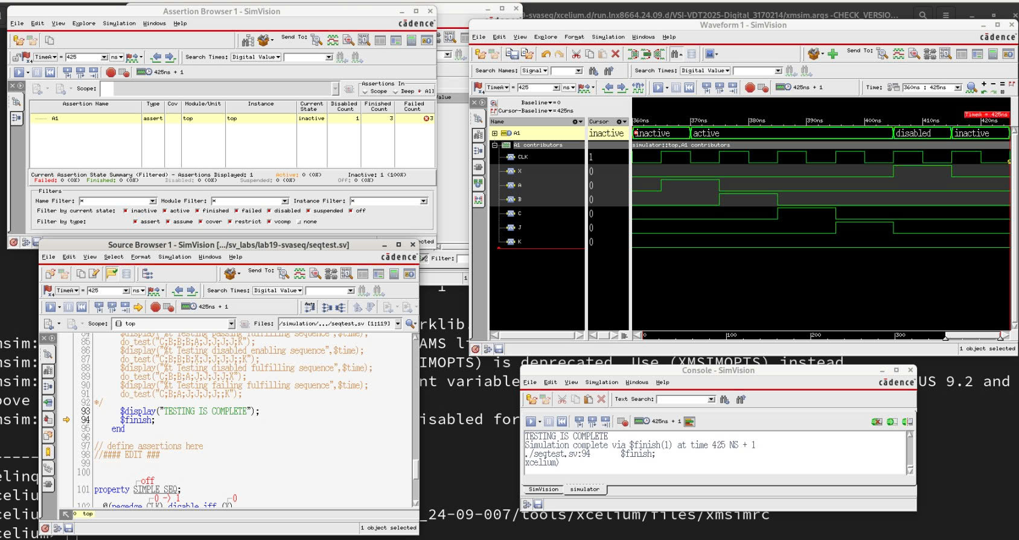
2. Simulating the Simple Sequence Assertion
02
Then continue to run until testing is complete as below:
Notes:
IC: Integrated Circuit

Slide 16
Creating the Complex Sequence Assertion
03

Slide 17
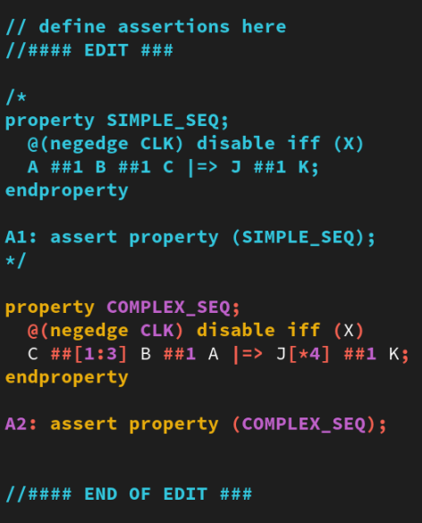
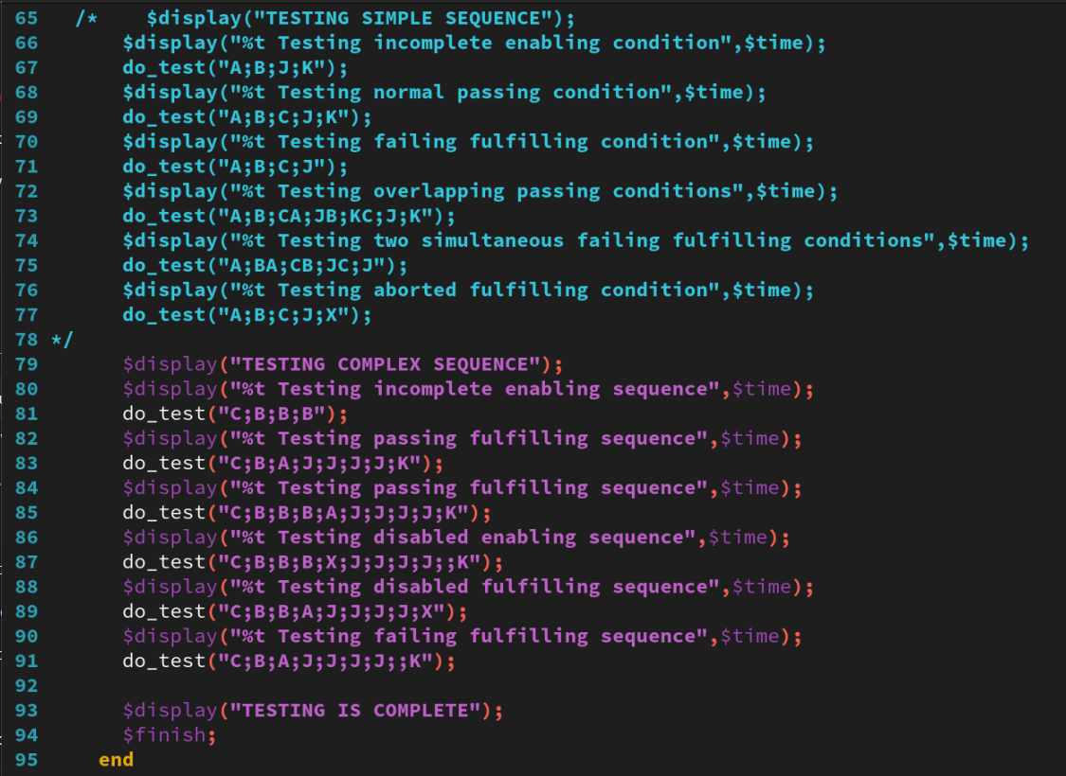
3. Creating the Complex Sequence Assertion
01
Add a complex sequence assertion COMPLEX_SEQ, clocked off the negative edge of CLK, to the following specification:
The enabling sequence is C at logic 1 followed immediately by between one and three samples, in which B is at logic 1 followed immediately by A at logic 1.
The fulfilling sequence follows in the cycle after the enabling sequence completes and is J at logic 1 for four samples, the last of which is followed immediately in the next sample by K at logic 1.
The assertion is disabled if X is at logic 1 for any cycle.
comment
comment
add new COMPLEX_SEQ
uncomment
Notes:
IC: Integrated Circuit

Slide 18
3. Stimulating the Complex Sequence Assertion
02
The steps of stimulation are the same as above(Simple Sequence Assertion).
Run the stimulation. If you have successfully created the complex sequence assertion, you should see one failure when you simulate the design.
First assertion failures(only one) at 6th run and the 6th subtest of the complex assertion fails to complete the fulfilling sequence – K does not immediately follow the fourth occurrence of J.
Notes:
IC: Integrated Circuit

Slide 19
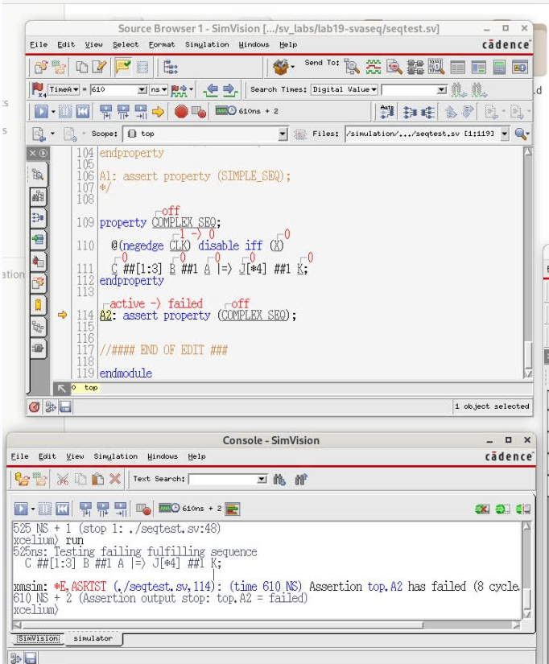
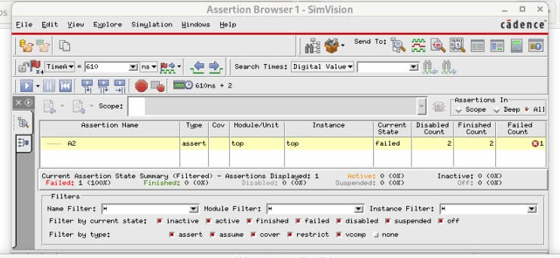
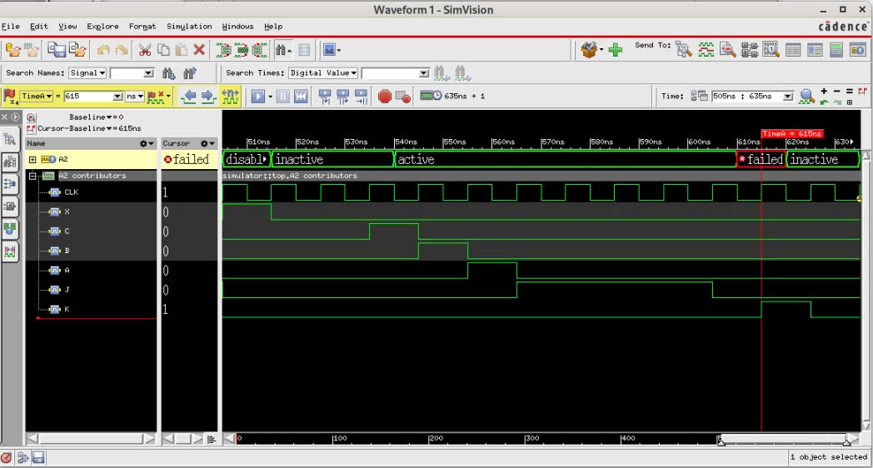
3. Stimulating the Complex Sequence Assertion
02
The result as below:
Notes:
IC: Integrated Circuit

Slide 20
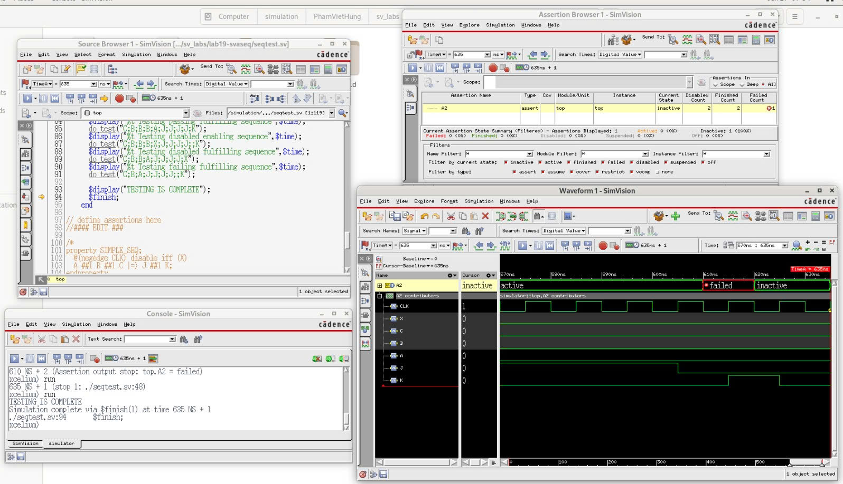
3. Stimulating the Complex Sequence Assertion
02
Then continue to run until testing is complete as below:
Notes:
IC: Integrated Circuit

Slide 21
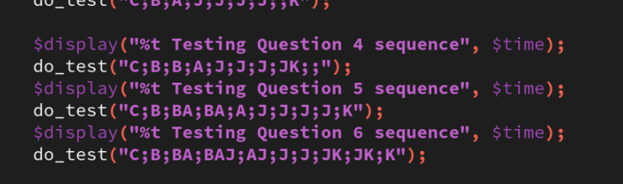
3. Stimulating the Complex Sequence Assertion
02
Add stimuli to explore and demonstrate answers to the following questions:
Question 4: If a K occurs in the same cycle as the fourth J, e.g.: C;B;B;A;J;J;J;JK;;
When and why does the assertion fail?
Notes:
IC: Integrated Circuit

Slide 22
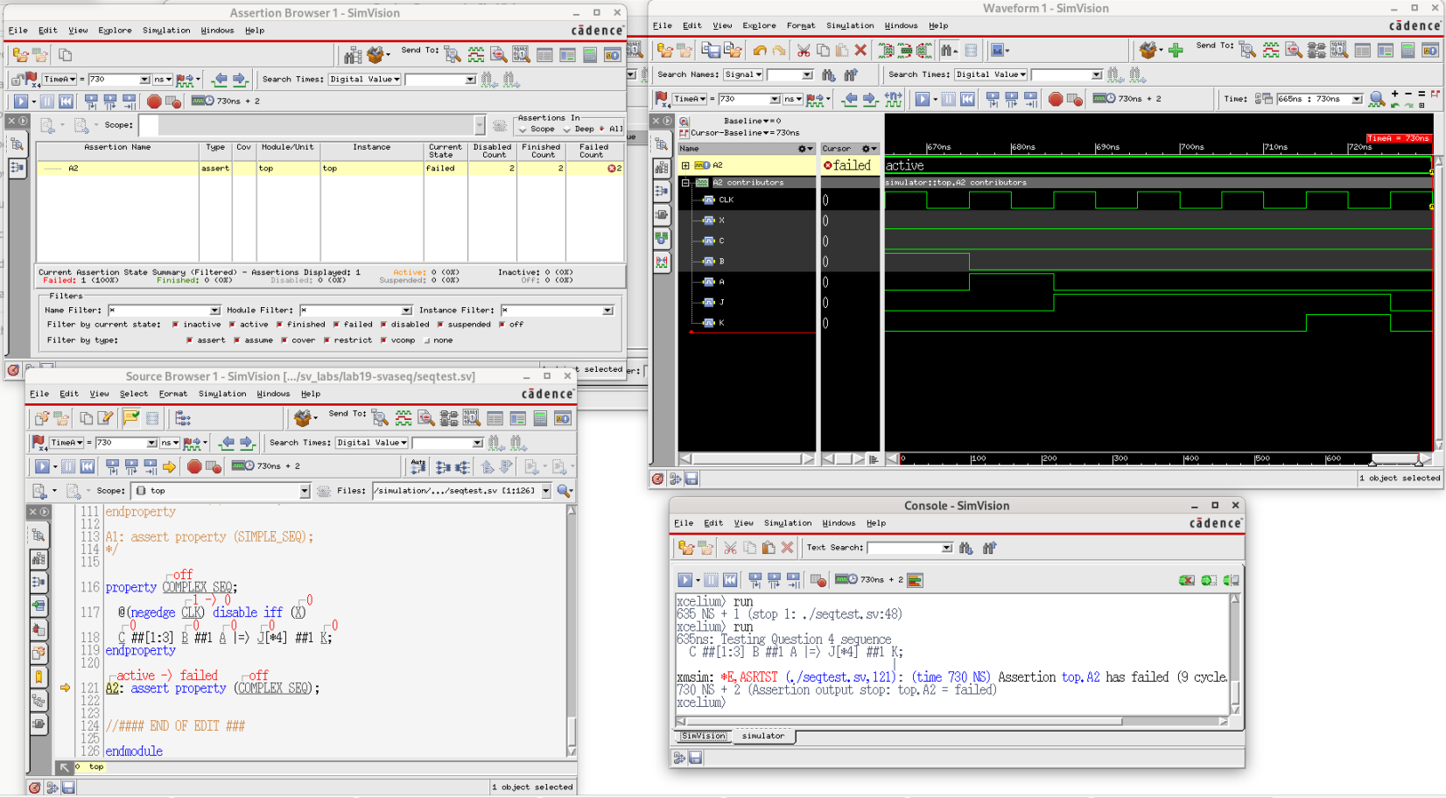
3. Stimulating the Complex Sequence Assertion
02
Answer: The assertion fails on the cycle following the 4th occurrence of J. K is not checked on the fourth occurrence of J but is checked in the cycle immediately following. As K is not found, the assertion fails.
Details as below:
Notes:
IC: Integrated Circuit

Slide 23
3. Stimulating the Complex Sequence Assertion
02
Add stimuli to explore and demonstrate answers to the following questions:
Question 5 – If multiple As occur in the same cycles as the second and third Bs, that is, from the stimulus: C;B;BA;BA;A;J;J;J;J;K;
How many assertions are enabled? How many fail? When and why do they fail?
Notes:
IC: Integrated Circuit

Slide 24
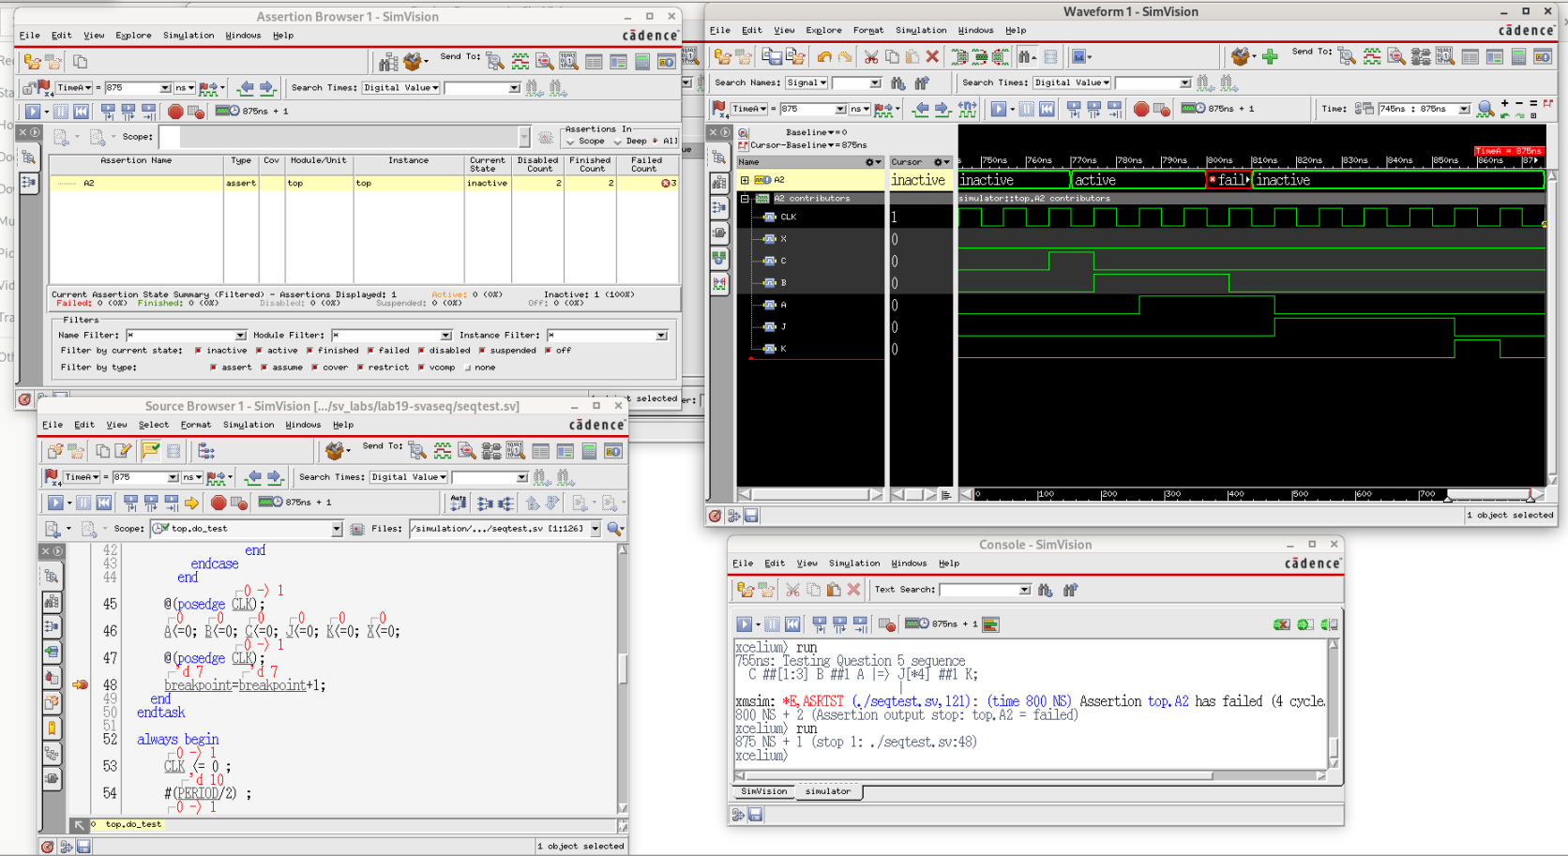
3. Stimulating the Complex Sequence Assertion
02
Answer: Three attempts start on cycle 1 and are enabled, at cycles 3, 4 and 5 of the above stimulus. The copy enabled on cycle 4 and cycle 3 fails because the first condition of the fulfilling sequence does not occur. The copy enabled on cycle 5 completes successfully.
Details as below:
Notes:
IC: Integrated Circuit

Slide 25
3. Stimulating the Complex Sequence Assertion
02
Add stimuli to explore and demonstrate answers to the following questions:
Question 6 – How can you modify the stimulus of Question 5 to ensure all assertions pass?
Notes:
IC: Integrated Circuit

Slide 26
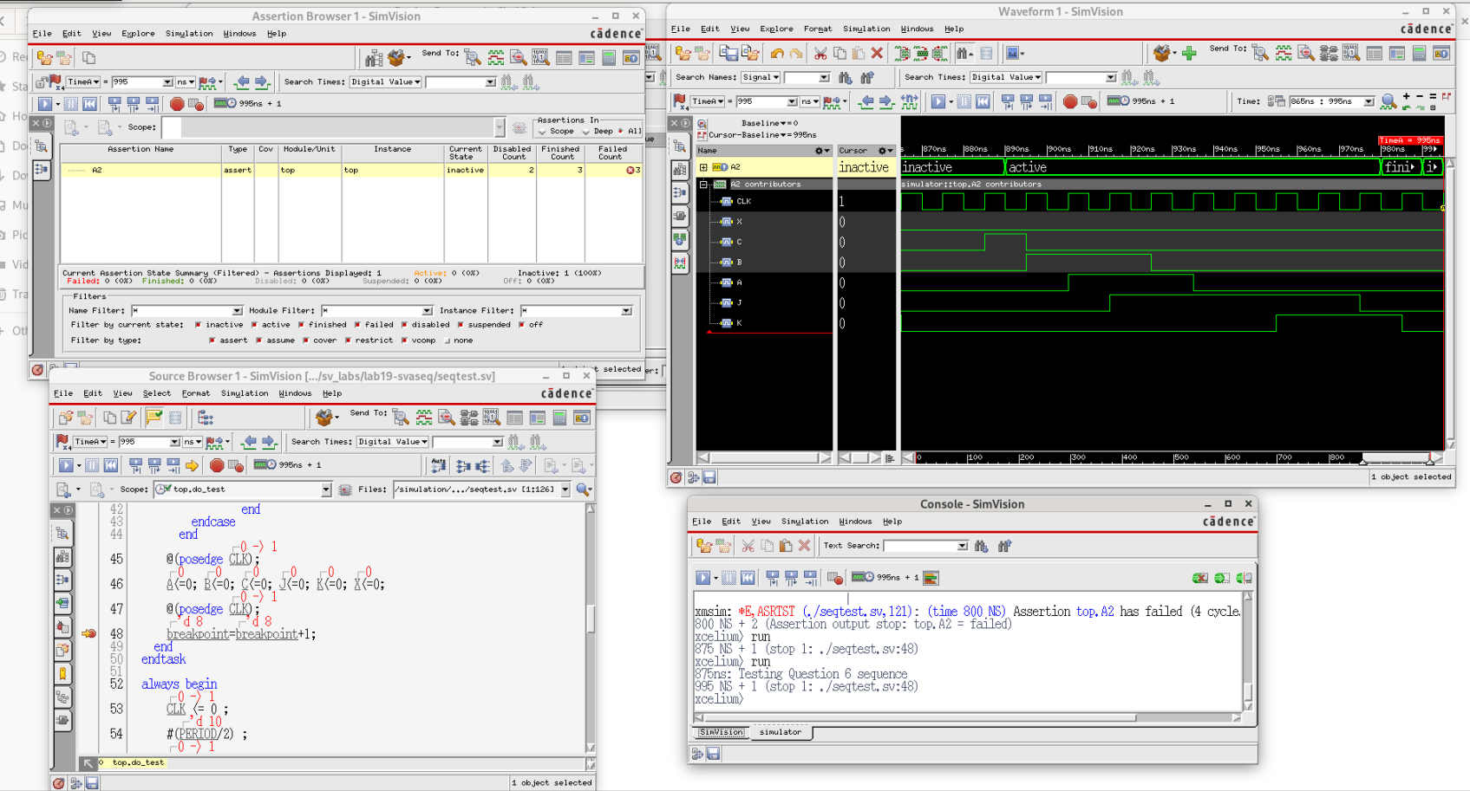
3. Stimulating the Complex Sequence Assertion
02
Answer: The following stimulus passes all the assertions: C;B;BA;BAJ;AJ;J;J;JK;JK;K;
Details as below(error free):
keep the same as previous slide
Notes:
IC: Integrated Circuit

Slide 27
Achieved Outcomes.
04

Slide 28
4. Achieved Outcomes
01
Understand the specification and create a simple and a complex sequence-based assertion.
Simulating them with a supplied testbench to explore how your simulator handles.
Reports the various states in a multicycle assertion evaluation.
Notes:
IC: Integrated Circuit

Slide 29

THANK YOU!

